Slide 1

AI Content Creator
From Text to Video Using AI Tools
Presented By
Course Information
Rawad Youssef
CSC211 – Introduction to Artificial Intelligence
Instructor: Mr. Jean Merhy
MODERN UNIVERSITY FOR BUSINESS & SCIENCE (MUBS)

Slide 2



Introduction / Problem
Content creation is time-consuming
Traditional manual workflows require significant hours devoted to conceptualization, scripting, and production.
Requires a diverse set of skills
Producing high-quality material demands simultaneous expertise in writing, voiceover acting, graphic design, and video editing.
High pressure on students
Many students struggle to deliver polished, professional presentations and videos under tight academic deadlines.
AI Content Creator | CSC211 | Modern University for Business & Science

Slide 3




Project Objective
Automated Creation
Simplified Workflow
Consistent Quality
Build an AI system that automatically creates short videos from a given topic.
Simplify the end-to-end video workflow using accessible and modern AI tools.
Reduce effort significantly while keeping output quality high and consistent.
AI Content Creator | CSC211 | Modern University for Business & Science

Slide 4




AI Approach
Generative AI
Generates project outline, structured script, and image prompts from the initial topic.
Automated Multimedia Pipeline
Our approach integrates state-of-the-art artificial intelligence models to fully automate the video production process.
Text-to-Speech
Converts the generated script into high-quality, natural-sounding voiceover narration.
By chaining specialized AI tools, we transform a simple text topic into a complete, polished multimedia presentation, eliminating manual bottlenecks and saving significant creation time.
Image Generation
Produces custom visual assets, illustrations, and b-roll footage matching the script.
Video Creation
Assembles the audio, generated visuals, and text into a final, synced timeline.
AI Content Creator | CSC211 | Modern University for Business & Science

Slide 5





Tools Used
ChatGPT
An Integrated AI Stack
Generates the engaging video script and precise image prompts.
To achieve a seamless content creation process, we leverage a specialized suite of accessible AI-powered applications.
Flow
Organizes and connects the sequence of AI workflow steps.
Nano Banana 2
Each tool is carefully selected to handle a specific part of the workflow—from initial script writing to final video assembly—ensuring a professional output with minimal manual effort.
Creates highly detailed, custom images from the generated prompts.
TTSMaker
Converts the text script into a natural, human-sounding voiceover.
Canva
Assembles the voice, generated visuals, and text into the final video.
AI Content Creator | CSC211 | Modern University for Business & Science

Slide 6








System Workflow
1. Topic
2. Script
3. Voice
4. Images
5. Video
Define core subject
Generate outline & text
Convert text to speech
Create visual assets
Assemble final presentation
AI Content Creator | CSC211 | Modern University for Business & Science

Slide 7



Script Example
generated_script.txt
[INTRO SCENE]
"Welcome! In this project, an AI assistant turns a topic into a short, engaging video. Step one: we expand the topic 'Benefits of Daily Biking' into a clear 45‑second script with intro, three key points, and a call to action."
[MAIN BODY]
"Next, we generate a natural voiceover and visuals that match each line. Finally, we assemble everything into a clean, modern video suitable for class presentations."
AI Content Creator | CSC211 | Modern University for Business & Science

Slide 8





Voice Generation (TTSMaker)
Input Script
Paste the finalized AI-generated script directly into the TTSMaker interface.
Generated Voice Sample
Configure Voice
Choose language (English), select an engaging voice profile, and adjust speed/pitch for a natural tone.
Export & Review
Download the generated audio as an MP3 file, and review it for clarity, pacing, and correct pronunciation.
AI Content Creator | CSC211 | Modern University for Business & Science

Slide 9



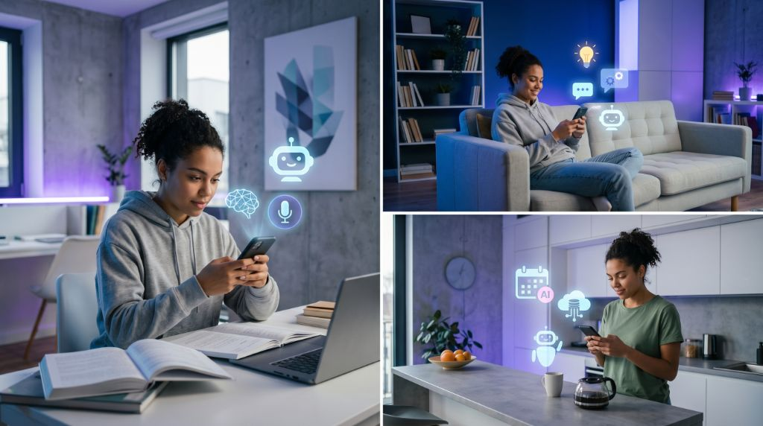
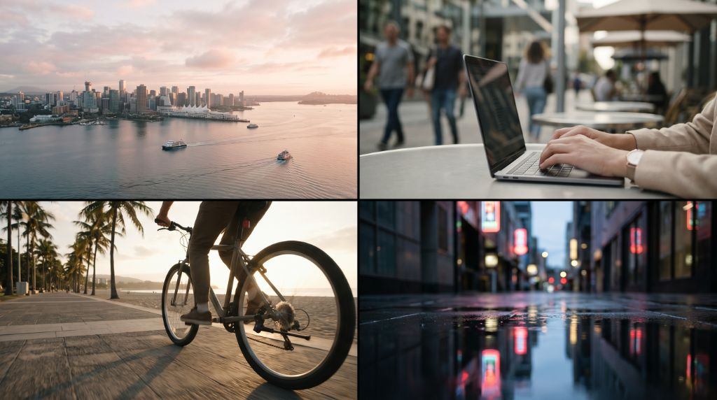
Image Generation
AI Prompt 1:
AI Prompt 2:
"Minimal, modern flat illustrations of AI chat interactions, blue/red accents, clean background"
"Urban b-roll shots and lifestyle cycling at sunrise, cinematic, soft light"
AI Content Creator | CSC211 | Modern University for Business & Science

Slide 10






Video Creation (Canva)
Import Media
Import the finalized MP3 voiceover and all generated AI images into the timeline.
Timeline Sync
Align visual scenes strictly to the script beats, and apply subtle smooth transitions between cuts.
Brand & Export
Project Output Preview
Apply MUBS color accents to titles and overlays, then export the final presentation as a 1080p MP4.
Generated video complete with narration and visuals
AI Content Creator | CSC211 | Modern University for Business & Science

Slide 11




Final Output
AI-Generated Video
Optimized Length
Reusable Workflow
Complete video featuring natural voice narration paired with dynamic AI-generated visuals.
Approximately 45–60 seconds long, perfectly timed and highly suitable for class demonstrations.
Consistent MUBS branding applied throughout, with a repeatable process for adapting new topics.
AI Content Creator | CSC211 | Modern University for Business & Science

Slide 12





Ethical and Social Impact
Misinformation Risk
AI Misuse & Deepfakes
AI tools can generate highly realistic but fabricated visuals and voices, increasing the risk of spreading false information.
There is significant potential for impersonation, malicious deepfakes, and creating content that violates personal privacy.
Copyright Concerns
Bias in AI Outputs
Generative models create ongoing challenges regarding intellectual property, image usage rights, and voice actor licensing.
Algorithms can inherit and inadvertently amplify skewed perspectives or harmful biases present in their training data.
AI Content Creator | CSC211 | Modern University for Business & Science

Slide 13



Conclusion
Streamlines Content Creation
AI simplifies the end‑to‑end workflow, seamlessly connecting initial topic generation directly to a polished visual and audio output.
Saves Time and Effort
Significantly reduces the hours students spend on manual production, allowing them to focus entirely on core concepts and quality.
Demonstrates Practical Integration
Showcases the real-world power of chaining multiple specialized AI tools to achieve complex, highly coordinated multimodal objectives.
AI Content Creator | CSC211 | Modern University for Business & Science

Slide 14




Thank You
Any Questions?
Rawad Youssef
Course: CSC211 – Introduction to Artificial Intelligence
AI Content Creator | Modern University for Business & Science

